Slide 1
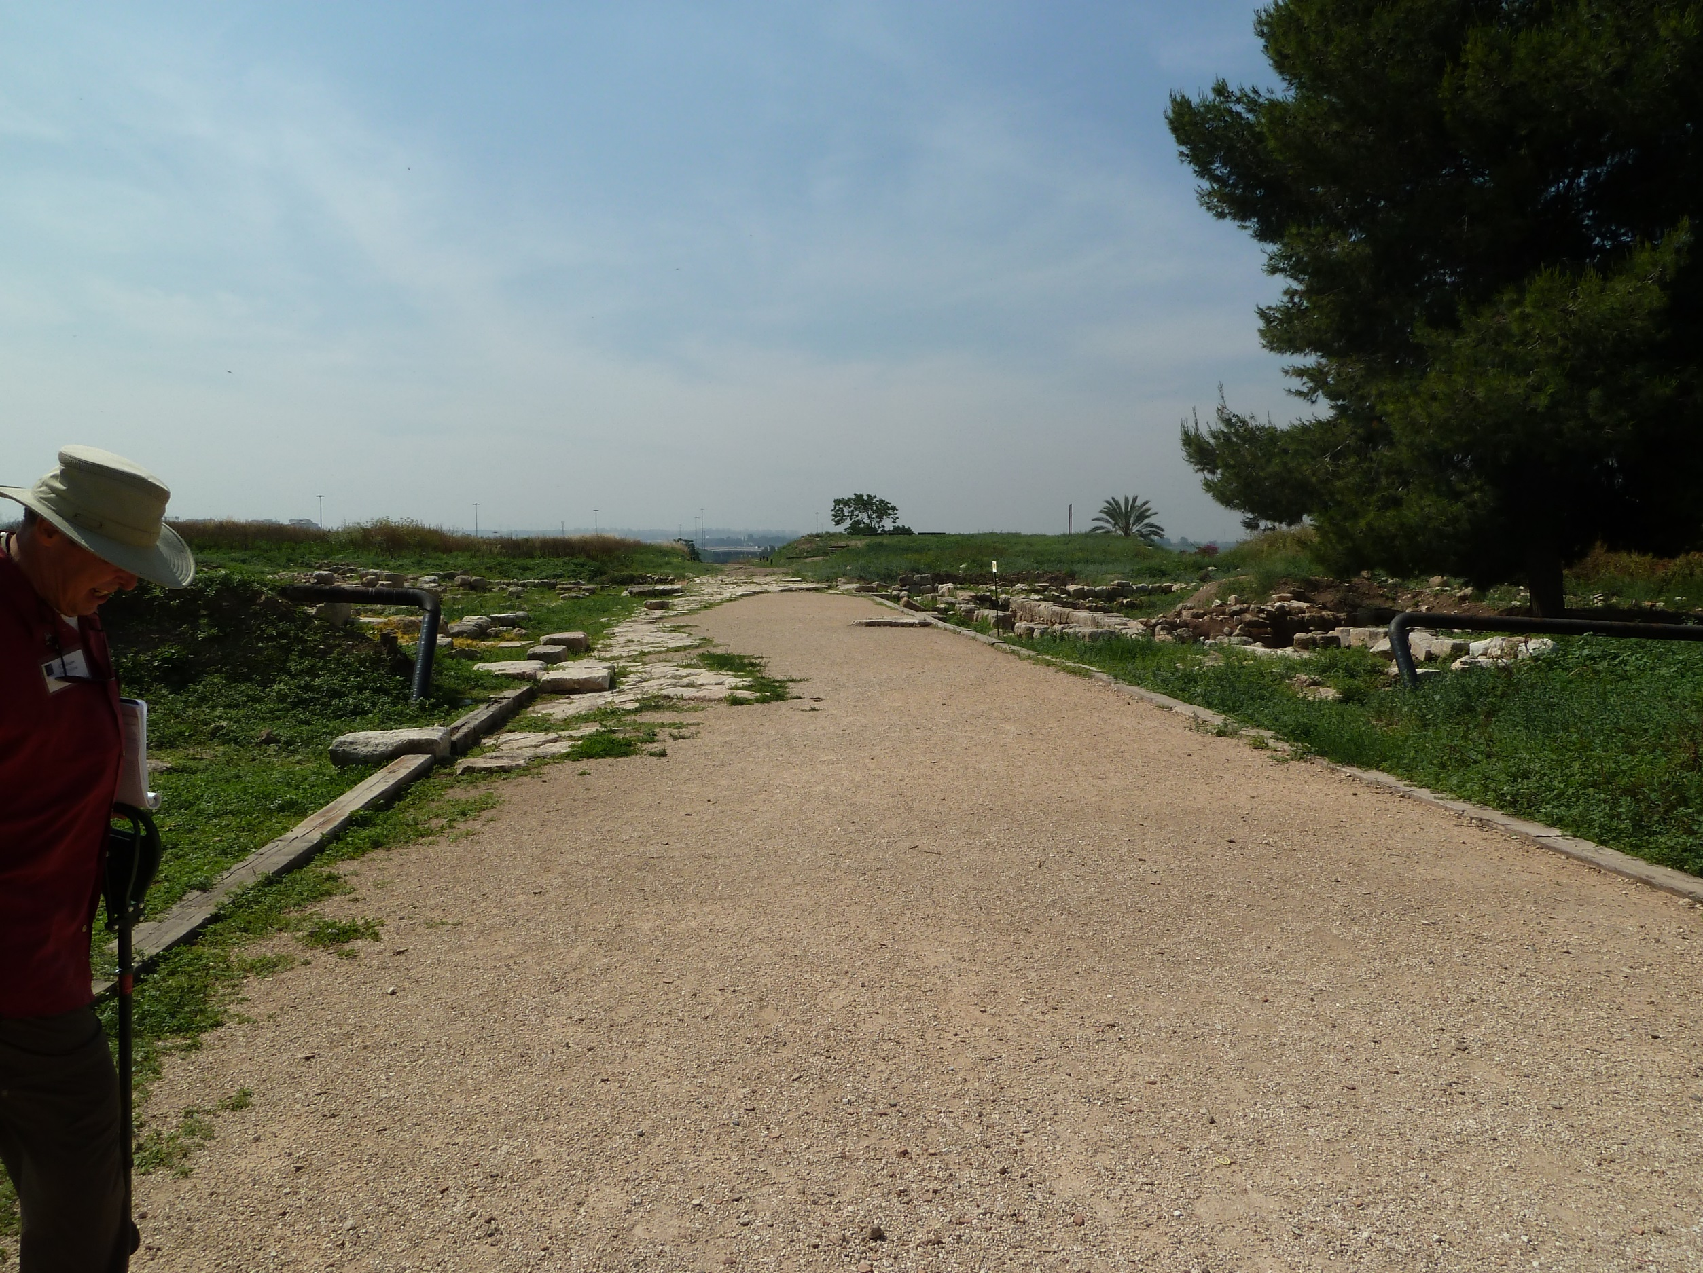
Herodian road at Aphek Antipatris

Slide 2
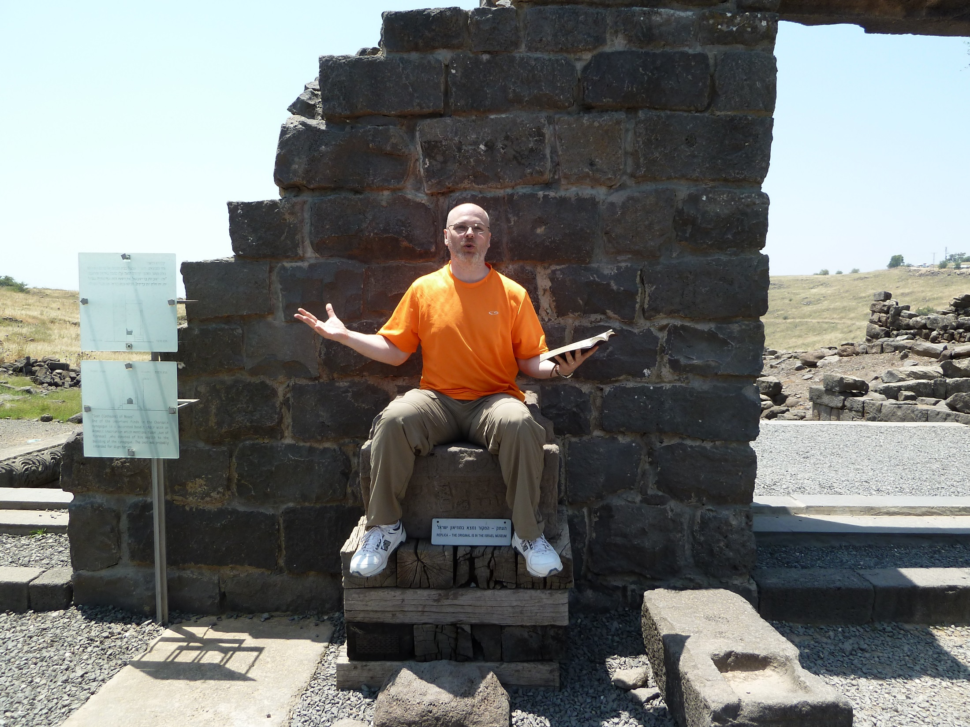

Slide 3

Proverbs 3.5-6 NASB:
⁵Trust in the LORD with all your heart / And do not lean on your own understanding.
⁶In all your ways acknowledge Him / And He will make your paths straight.

Slide 4
Proverbs 3.5-6 NASB:
5a: Trust in the LORD with all your heart
5b: And do not lean on your own understanding.
6a: In all your ways acknowledge Him
6b: And He will make your paths straight.

Slide 5
Proverbs 3.5-6 NASB:
5a: Trust in the LORD with all your heart

Slide 6
Proverbs 3.5-6 NASB:
5a: Trust in the LORD with all your heart
לֵב
physical heart or inner being, will, mind…

Slide 7
Proverbs 3.5-6 NASB:
5a: Trust in the LORD with all your heart
5b: And do not lean on your own understanding.

Slide 8
Proverbs 3.5-6 NASB:
5a: Trust in the LORD with all your heart
5b: And do not lean on your own understanding.
Proverbs 2.6 NIV:
For the LORD gives wisdom; from his mouth come knowledge and understanding.

Slide 9
Proverbs 1-9:
Solomon
Wisdom
= Revelation of God
Son
True Spiritual Life

Slide 10
Proverbs 1-9:
Solomon
Satan
Wisdom
= Revelation of God
Folly
[Human Reasoning]
Son
True Spiritual Life
Spiritual Death

Slide 12
Solomon
Satan
Wisdom
= Revelation of God
Folly
[Human Reasoning]
Son
True Spiritual Life
Spiritual Death

Slide 13
Proverbs 3.5-6 NASB:
5a: Trust in the LORD with all your heart
5b: And do not lean on your own understanding.
6a: In all your ways acknowledge Him

Slide 14
Proverbs 3.5-6 NASB:
5a: Trust in the LORD with all your heart
5b: And do not lean on your own understanding.
6a: In all your ways acknowledge Him
יָדַע
“to know”

Slide 15
Proverbs 3.5-6 NASB:
5a: Trust in the LORD with all your heart
5b: And do not lean on your own understanding.
6a: In all your ways acknowledge Him
6b: And He will make your paths straight.

Slide 16
Proverbs 3.5-6 NASB:
6b: And He will make your paths straight.
Proverbs 15.21 NIV: “Folly brings joy to one who has no sense, but whoever has understanding keeps a straight course.”

Slide 17
Proverbs 3.5-6 NASB:
Trust in the LORD with all your heart / And do not lean on your own understanding. In all your ways acknowledge Him / And He will make your paths straight.
Trust completely in Yahweh and his revelation in the Bible, and don’t rely on your own faulty thinking; know Yahweh intimately in every aspect of your life, and he will bring you on the straight path of true spiritual life…

